Slide 1
Welcome to YUVTARANG 2K16 – TECHNICAL FEST
quiz

Slide 2




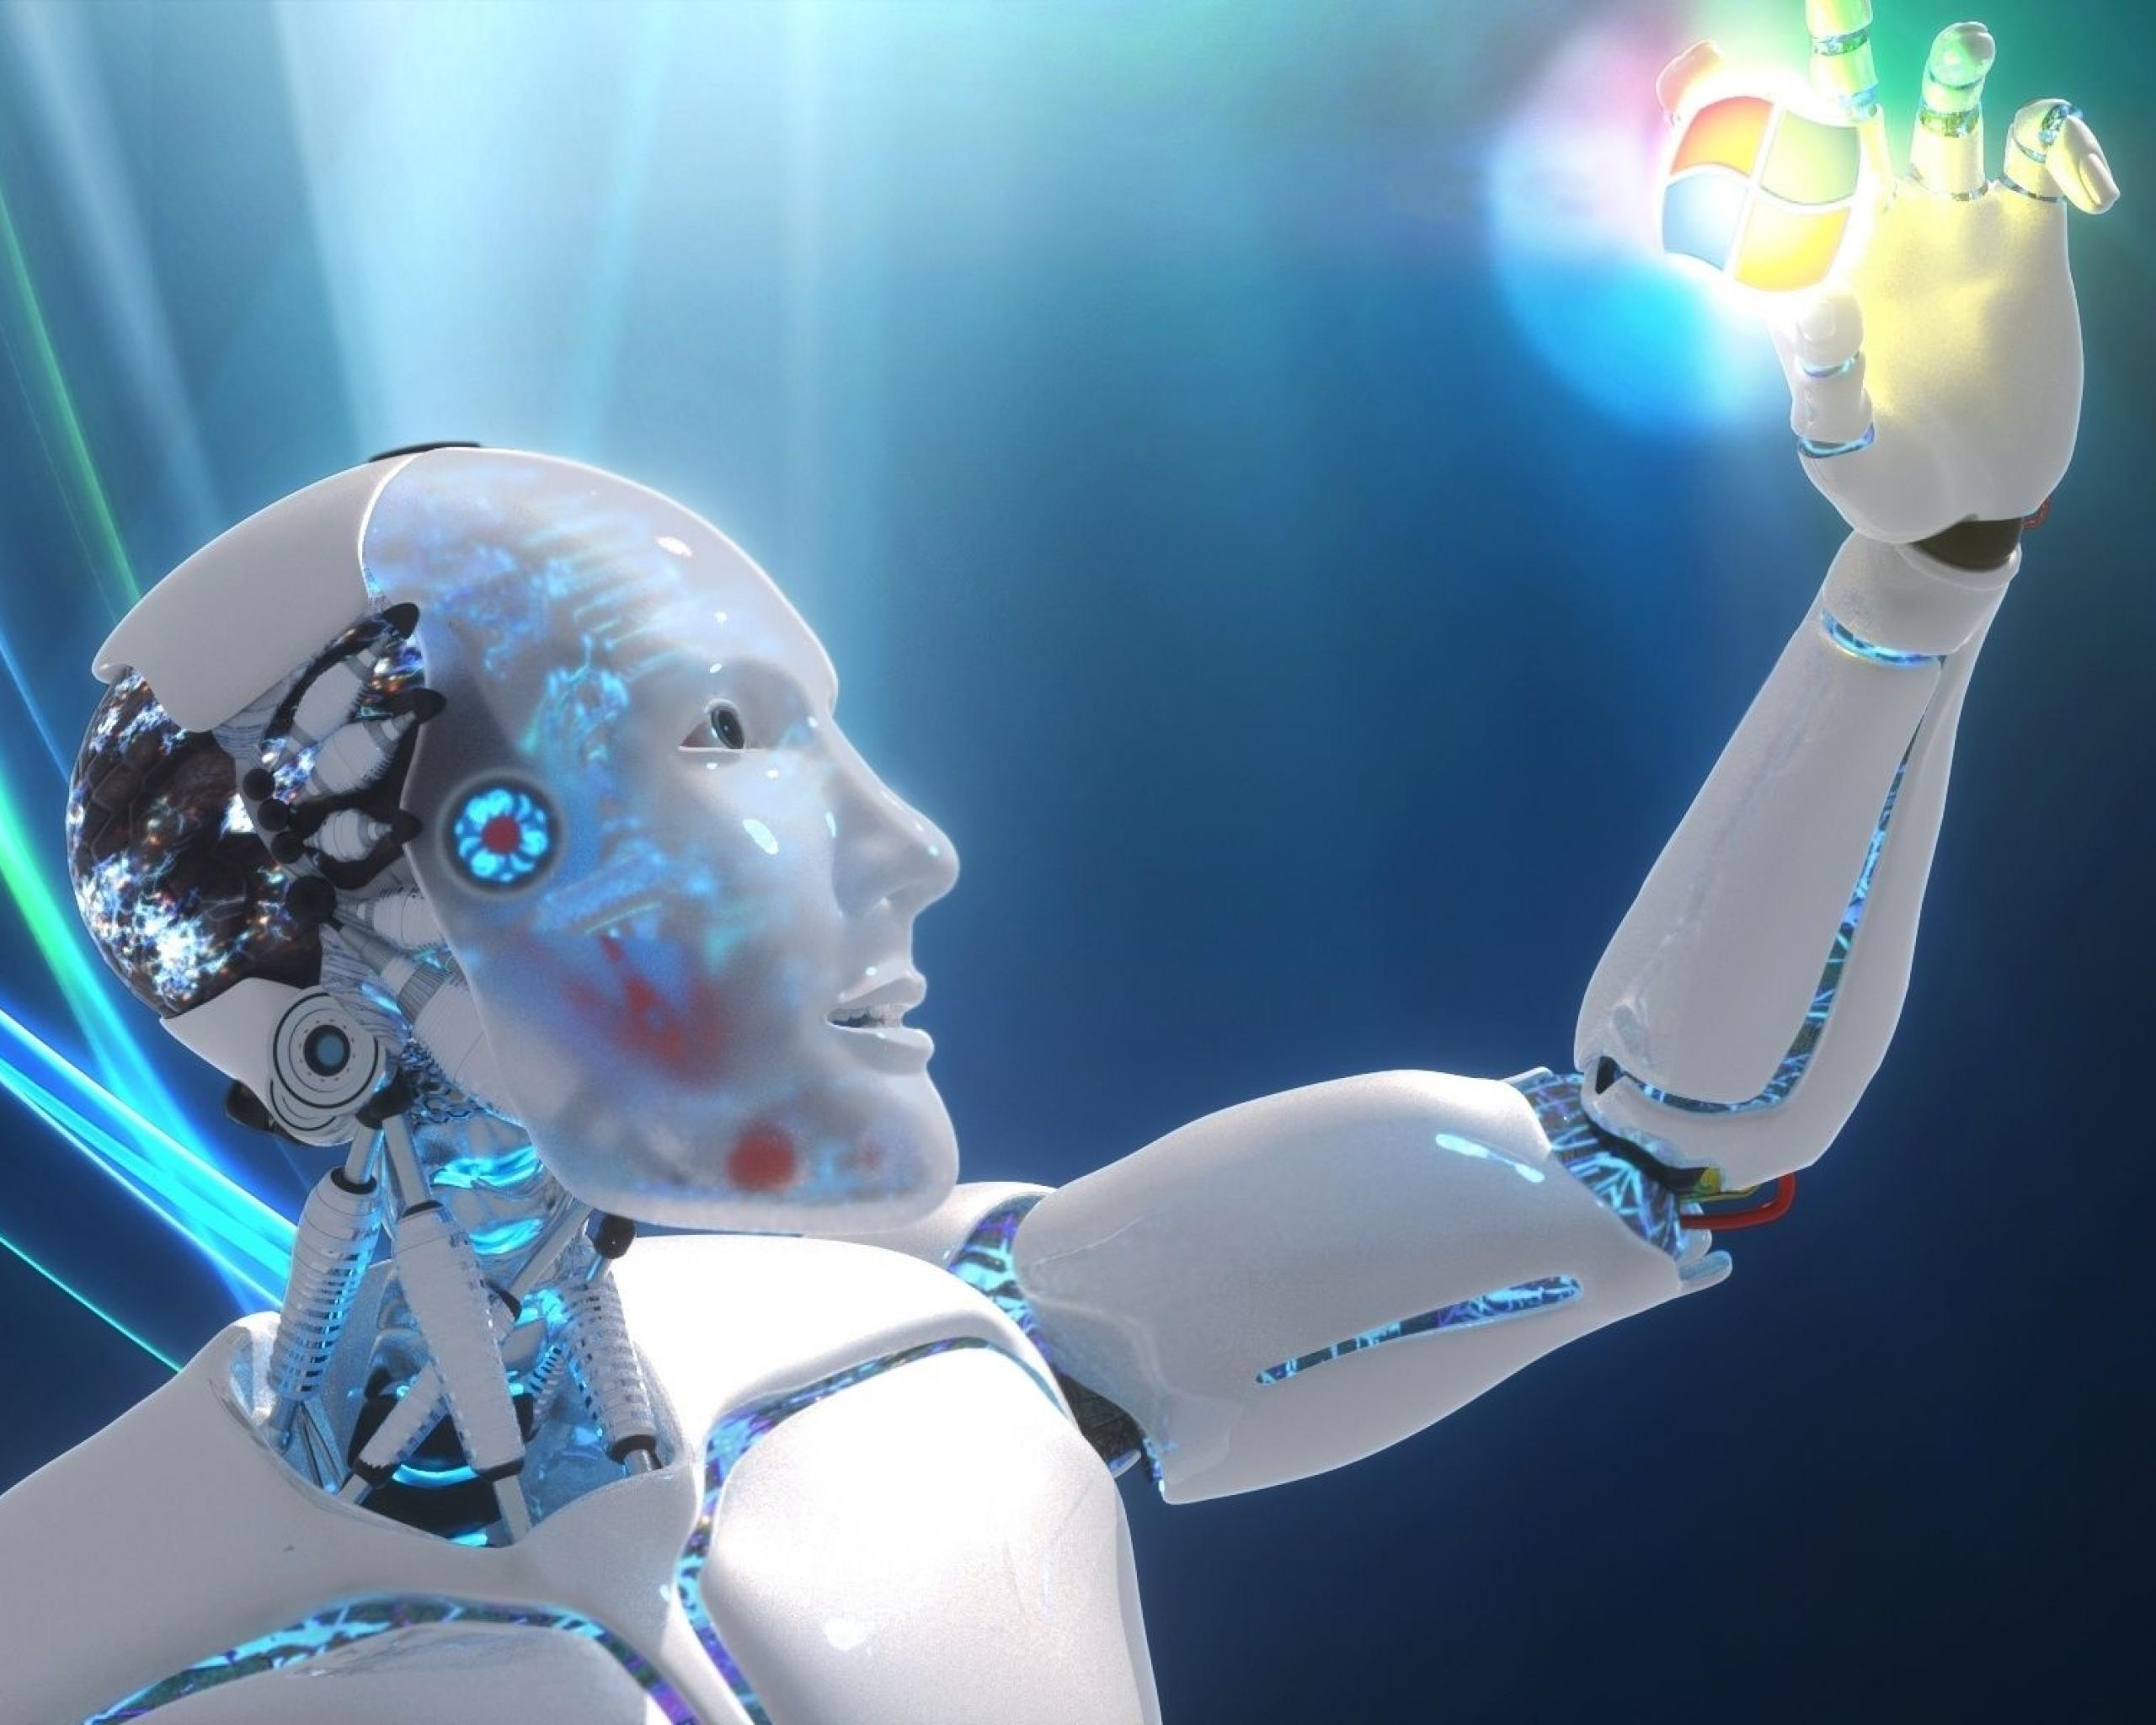
HOW ?
PRELIMINARY ROUND
FIVE QUESTIONS – EACH 10 POINTS
a) Movies
b) Sports
c) Science and Technology
d) General Knowledge
e) Eminent personalities
Duration : 30 seconds per question
No pass questions

Slide 3
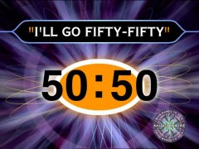
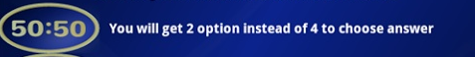

FINAL ROUND
15 QUESTIONS
THREE CHECKPOINTS
5,10,15
THREE LIFELINES
a) Add 60 seconds
b) 50-50
c) Flip the question
“I Quit” is enabled after 12 question

Slide 4
Organizing Committee
FACULTY COORDINATOR
Mr B. PRASANTH KUMAR
STUDENT COORDINATORS
Ch. SAI SUDHAKAR
N.SRI HARSHA

Slide 5
Organizing Committee
CORE TEAM
T. SRAVYA
Y.RAVALI
PRASANNA VARMA
M.SOHAN
A.HARSHIT
CANVASSING TEAM
A.RAMYA
V. TEEKSHANA PRIYA

Slide 6
Organizing Committee
TECHNICAL TEAM
S. HEMANTH - PRELIMINARY ROUND
Ch. SESHU - FINAL ROUND
ANCHOR
P. VAMSI KRISHNA
SOUND MIXING
PRASANNA VARMA

